Slide 1
Dedicated to all Homoeopathic devotees
Dr. P.R. Sisir M.D. (Hom.)
Professor & Head
Department of Paediatrics

Slide 2
CHILDHOOD PROBLEMS RELATED TO LEARNING DISABILITY
&
SCHOLASTIC BACKWARDNESS AMONG CHILDREN
Dr. P. R. SISIR M.D. (Hom)
Prof. & Head, Dept. of Paediatrics
Sarada Krishna Homoeopathic Medical College,
Kulasekharam, Kanyakumari Dist., Tamil Nadu.
drsisirpr@rediffmail.com

Slide 3
A WORD OF GRATITUDE
SIGNIFICANCE OF THE TOPIC
PLAN OF PRESENTATION

Slide 4
KINDLY WATCH THIS CASE &
ANALYSE IT WITH YOUR ERUDITE EXPERIENCE:
SOURSE OF CASE: Sarada Krishna Homoeopathic Medical College Hospital
PRELIMINARY INFORMATION:
O. P. No.: 1722 / 10 Date of Detailed Case Study: 10.07.2013 Unit: V A/B
Name: Anandhu Age: 10 yrs. Sex: M Religion: Hindu Occupation: student(std. V)
INITIAL PRESENTATION OF ILLNESS:
PATIENT’S NARRATION
PHYSICIAN’S OBSERVATION
While case taking child is not looking at us.
Just playing with windows & peeping out…..

Slide 5
PRESENTED COMPLAINTS:
Reduced interest in studies
Memory weak, esp. in studies
Articulation of certain letters – ‘C’ , ‘S’ , ‘X’ – are pronounced as ‘F’
Poor in mathematical calculations
Interested in: Drawing, Cartoons, Animal Planet(TV Channel)
Lack of ? Concentration
Eye contact
HISTORY:
Eye: Refractive error – using Spectacles…
Skin complaints(? Dematitis, back of hands) – allopathic treatment
Left leg bowing(identified @ 4 yrs.)
Dental procedures done due to Ca deficiency
Recurrent attack of cold
? IBS
Father (39) suffering from Asthma

Slide 6
DEVELOPMENTAL MILESTONES:
Birth Weight – 3 Kg.
No significant delay in milestone identified
CONDITION OF MOTHER DURING PREGNENCY / LABOUR:
Ante-natal period mother was alone at home, surrounded by forest…!
Pain induced for Labour & was prolonged.
LIFE SPACE ABSTRACT:
Obstinate. Want things he demands
Easily move to tears, but also get angered
Fights with brother for toys
Self oriented. Need attention.
Mingles with very close ones only.
Lazy
Timid
Jealous

Slide 7
APPEARANCE:
Thin, Wheaty, Healthy & Clean
Decayed & slightly protruded teeth
SIGNIFICANT GENERALS:
Desire fanning (+++), Sweets(++), Fried fish.
Aversion clothing (++), Bathing(+++), Rice, Egg, Vegetables
SIGNIFICANT PHYSICAL EXAMINATION:
Weight – 24 Kg.
Analysis & Rx
?

Slide 8
SYMPTOMS ANALYSED & TAKEN FOR REPERTORIZATION:
Timidity
Jealousy
Dullness in Children
Concentration difficult
Memory – Weakness of, read for what has
Excitement
Aversion – Egg
Desire – Sweets
Bathing – dreads of
On 13.07.2013 Rx
Sulph 200
Follow ups
26.07.2013 to 13.11.2013
DRx
Sulph
Calc. carb Calc. phos Lyco

Slide 10
Principles of the Clinical Interview
Efficient communication requires unbroken attention
Adequate time for interview
Create rapport with both family & child
Use of “Paediatric Symptom Checklist” (PSC)
Use a developmental approach to Interviewing children
Have an understanding of Psychological Disorders of Children –
Neurodevelopmental Dysfunctions
Counseling of Parent, Teachers, Close relatives…

Slide 11
Paediatric Symptom Checklist
1. Complaints of Aches & Pains
2. Spends more time alone
3. Tires easily, has little energy
4. Has trouble with teacher
5. Fidgety, unable to sit still
6. Less interested in school
7. Acts as if driven by a motor
8. Daydreams too much
9. Distracted easily
10. Is afraid of new situations
11. Feel sad, unhappy
12. Is irritable, angry
13. Feels hopeless
14. Has trouble concentrating
15. Less interested in friends
16. Fights with other children
17. Absent from school
18. School grades dropping
19. Is down on him / herself
20. Visits doctor with doctor finding nothing wrong
21. Has trouble sleeping
22. Worries a lot
23. Wants to be with you more than before
24. Feels he or she is bad
25. Takes unnecessary risks
26. Gets hurts frequently
27. Seems to be having less fun
28. Acts younger than children of his/her age
29. Does not listen to rules
30. Does not show feelings
31. Does not understand other people’s feelings
32. Teases others
N – Never S – Sometimes O - Often

Slide 12
Developmental Approach to Interviewing
INFANCY & TODDLERHOOD
PRESCHOOL CHILDREN
SCHOOL-AGED CHILDREN
ADOLESCENTS

Slide 13
Neurodevelopmental Dysfunctions
Neurodevelopmental function is a basic brain process that may be needed for
learning & productivity.
Neurodevelopmental variation is the differences in neurodevelopmental
strengths weaknesses that exist between individuals & that can change over time.
Wide variations exist among individuals, without representing pathology.
Neurodevelopmental dysfunctions reflect disruption of neuroanatomic structures or
psychophysiologic functions and is said to be associated with academic
under achievements, behavioral problems & social adjustments.
Factors – Genetic (on chromosomes 6 & 15),
Medical (peri-natal risks),
Environmental (Lead toxins, infections),
Socio-cultural influences.

Slide 14
Neurodevelopmental Dysfunctions – CLINICAL MANIFESTATIONS
Neurodevelopmental functions that are critical for academic function fall within
the following domains:
ATTENTION
MEMORY
LANGUAGE
VISUAL-SPACING ORDERING
TEMPORAL-SEQUENTIAL ORDERING
NEUROMOTOR FUNCTION
HIGHER-ORDER COGNITION
SOCIAL COGNITION

Slide 15
Neurodevelopmental Dysfunctions – CLINICAL MANIFESTATIONS
ACADEMIC EFFECTS – Reading,
Spelling,
Writing,
Mathematics,
Content area subjects.
NONACADEMIC &
EMOTIONAL EFFECTS - Sadness,
Self-deprecatory comments, Declining self-esteem,
Chronic fatigue,
Loss of interests,
Suicidal ideation
Depression
Pessimism
Loss of Ambition…

Slide 16
Neurodevelopmental Dysfunctions – MANAGEMENT
Multidisciplinary - Demystification
Bypass strategies(Accommodations)
Interventions(Remediation of Skills)
Developmental therapy
Curriculum modification
Strengthening of strengths
Individual & Family Counseling
ROLE OF HOMOEOPATHY & HOMOEOPATH

Slide 17
KINDLY GO THROUGH ANOTHER CASE & ANALYSE IT:
SOURSE OF CASE: Sarada Krishna Homoeopathic Medical College Hospital
PRELIMINARY INFORMATION:
O. P. No.: 5207 / 13 Date of Detailed Case Study: 10.06.2013 Unit: V A/B
Name: Sujith Age: 11 yrs. Sex: M Religion: Christian Occupation: student(std. VII)
INITIAL PRESENTATION OF ILLNESS:
PATIENT’S NARRATION
PHYSICIAN’S OBSERVATION
Plays alone….
Eye contact present….
Reading difficult…..
Good in drawing….but makes mistakes in drawing

Slide 18
PRESENTED COMPLAINTS:
No interest in studies since 4 yrs
Aversion to reading books from std II onwards
Reading is difficult
Desire to play alone
Dull, sleeps in class. Otherwise active..!
Goes to school regularly
Social contacts –
Tell lies on study related issues..!
Interested in birds & animals, sports, TV…
Mathematical calculations difficult…

Slide 19
HISTORY (past):
6 months – Surgery done for Hernia
Eye: Refractive error – Myopia
9 yrs. – Fracture (rt. Arm)
10 yrs. - Tonsillectomy
HISTORY (Family):
Mother(40) – Taking medicines for allergic manifestations
Grand father(65) & mother(58) – Diabetic & Hypertensive
Brother – Cerebral Palsy…
HISTORY (Personal):
Family status – Nuclear
Siblings – 2 (One brother & one sister)
Birth: Premature – Birth wt. – 1.600 Kg. Was kept in NICU for 45 days
c/o abdominal distension & vomiting
Congenital anomaly: ? Hernia
Developmental milestones: All, except talking, normal.

Slide 20
HISTORY (Personal)contd.:
Condition of Mother during pregnancy & labour:
Pain from 3rd month onwards. Advised bed rest
6th month – Amniotic cavity ruptured. Hospitalised for 25 days
Spontaneous labour pain. Labour procedure for 1 hr.
Delivered a premature child, which cried soon after birth.
LIFE SPACE ABSTRACT:
Lazy
Timid
Lack of concentration
Weak memory
Revengeful with sister
Desire company (+)
Desire travel (++)

Slide 21
APPEARANCE:
Thin, Dark complexion, Healthy & Clean
Decayed molar tooth
SIGNIFICANT GENERALS:
Sweat increased, whole body, esp. head & face
Desire cold season
Aversion to vegetables
Desire fried rice, noodles, biriyani, salt, egg
Tendency to catch cold easily
T.R. – towards hot
SIGNIFICANT PHYSICAL EXAMINATION:
Weight – 33 Kg.
Chest circumference – 63 cm
Mid-arm circum – 20 cm
Head circum – 50 cm
Analysis & Rx
?

Slide 22
SYMPTOMS ANALYSED & TAKEN FOR REPERTORIZATION:
Concentration difficult-studying, reading
Dullness – children
Timidity
Memory weakness of – write for what is
Liar
Aversion – vegetables
Desire – salt things
Cold - tendency to take
Head – Perspiration, scalp
Face - Perspiration
S DSM IV – AD / HD
- Inattentive type
DRx
Calc. carb
Natrum mur
Lycopo
Sulph
Merc.
On 22.06.2013 Rx
Natrum mur 1M
Follow up
13.07.2013

Slide 23
ESTIMATES OF PREVALENCE OF LEARNING DISABILITY RANGE FROM 3 -10 %
WHILE ATTENTION DEFICITS 4 – 12 % OF SCHOOL-AGED CHILDREN.
Medical Classification Systems include:
American Psychiatric Association – Diagnostic & Statistical Manual of Mental
Disorders, 4th Edition (DSM – IV)
International Classification of Diseases (ICD)
THE DSM – IV DIFFERENTIATES LEARNING DISORDERS FROM MOTOR SKILL DISORDER &
COMMUNICATION DISORDER…
NOW LETS WATCH A CHILD IN OPD
&
TRY TO ANALYSE

Slide 25
CLASSIFICATION OF PSYCHIATRIC DISORDERS OF CHILDREN & ADOLESCENTS
Specific Developmental Disorders
Pervasive Developmental Disorders
Externalizing Disorders
Internalizing Disorders
Hyperkinetic Disorders
Miscellaneous

Slide 26
CLASSIFICATION OF PSYCHIATRIC DISORDERS OF CHILDREN & ADOLESCENTS
Specific Developmental Disorders
Mental Retardation
Disorders of Speech & Language
Developmental articulation Disorder
Stuttering
Expressive Language Disorder
Receptive Language Disorder
Disorders of Scholastic Skills
Reading Disorder
Writing Disorder
Mathematics Disorder
Developmental Co-ordination Disorder

Slide 27
CLASSIFICATION OF PSYCHIATRIC DISORDERS OF CHILDREN & ADOLESCENTS
Pervasive Developmental Disorders:
Autistic Disorder
Rett’s Syndrome
Asperger’s Syndrome
Childhood Disintegrative Disorder (CDD)
Externalizing Disorders:
Conduct Disorder
Oppositional defiant Disorder
lnternalizing Disorders:
Separation Anxiety Disorder
Phobic Anxiety Disorder
Social Anxiety Disorder
Depressive Disorder

Slide 28
CLASSIFICATION OF PSYCHIATRIC DISORDERS OF CHILDREN & ADOLESCENTS
Hyperkinetic Disorders
Attention-Deficit Hyperactivity Disorder
Miscellaneous
Tourette’s Disorder
Nocturnal Enuresis
Encopresis

Slide 29
CAUSES FOR SCHOLASTIC BACKWARDNESS
VISUAL DEFICITS
HEARING DEFICITS
SPECIFIC LEARNING
DISABILITIES
A.D.H.D.
LOW I.Q.
BEHAVIOURAL PROBLEMS
SOCIAL PROBLEMS
Medications:
Anticonvulsants
Bronchodilators

Slide 30
KINDLY GO THROUGH ANOTHER CASE & ANALYSE IT:
SOURSE OF CASE: Sarada Krishna Homoeopathic Medical College Hospital
PRELIMINARY INFORMATION:
O. P. No.: 6597 / 13 Date of Detailed Case Study: 02.07.2013 Unit: V A/B
Name: Sabarinath Age: 15 yrs. Sex: M Religion: Hindu Occupation: student(std. Xth )
INITIAL PRESENTATION OF ILLNESS:
PATIENT’S NARRATION
PHYSICIAN’S OBSERVATION
Vertigo with sensation to fall forward
Vomiting
Introverted
Not able to tell about his complaints properly

Slide 31
PRESENTED COMPLAINTS:
LOCATION
SENSATION
= , <, >
ACCOMPANIMENTS
Gen.
Since 2 yrs
Vertigo
Fall forward feel
< Mental exertion
Syncope
GIT
Since 2 yrs
Vomiting
< Early morning
< Travelling in bus
< Rising from bed
Chest
Since 2 wks
Palpitation
< Mental tension
< Mental exertion
HISTORY ( Past):
A Trauma at the age of 4 yrs
HISTORY ( Family):
Father – Diabetic
Grand father – ? Eczema, Hypertension
HISTORY ( Personal):
Nuclear fly, Milestones – WNL, Birth weight: Low

Slide 32
LIFE SPACE ABSTRACT:
Easily get angry esp. towards parents
Fears to be alone
Anxious about his complaints
Unable to attend classes due to his complaints
Tension / anxiety about further studies
Interested in watching TV & Travel.
Fastidious
Things that time passes slowly…

Slide 33
APPEARANCE:
Thin, Small stature, Fair complexion, Healthy, Childish
SIGNIFICANT GENERALS:
Sleep disturbed at night, sleeps better during day
Desire fanning
Desire fried fish
T.R. – towards hot
SIGNIFICANT PHYSICAL EXAMINATION:
Weight – 38 Kg., Height – 158 cms
Analysis & Rx
?

Slide 34
SYMPTOMS ANALYSED & TAKEN FOR REPERTORIZATION:
Time passes too slowly
Fear alone of being
Vertigo – fall tendency, forward
Vertigo – syncope with
Vertigo – mental exertion
Desire fried food
Sleepiness day(morning)
Vomiting morning
Vomiting motion on
Chest palpitation, mental exertion
DRx
Nux vom
Sulphur
Lycopodium
Phosphorus
Lachesis
Natrum mur
On 06.07.2013 Rx
Nux vom 1M
Follow up
20.07.2013 to 18.10.2013….

Slide 35
Few words about the institute I am working….
&
And its working plan…

Slide 36
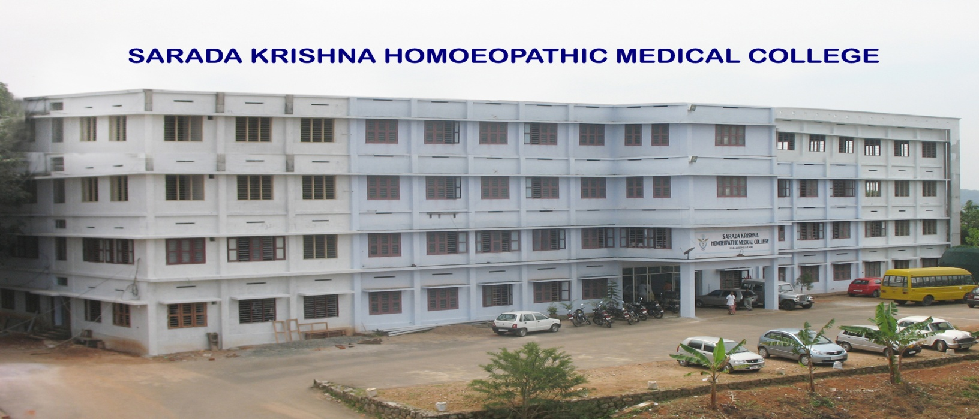
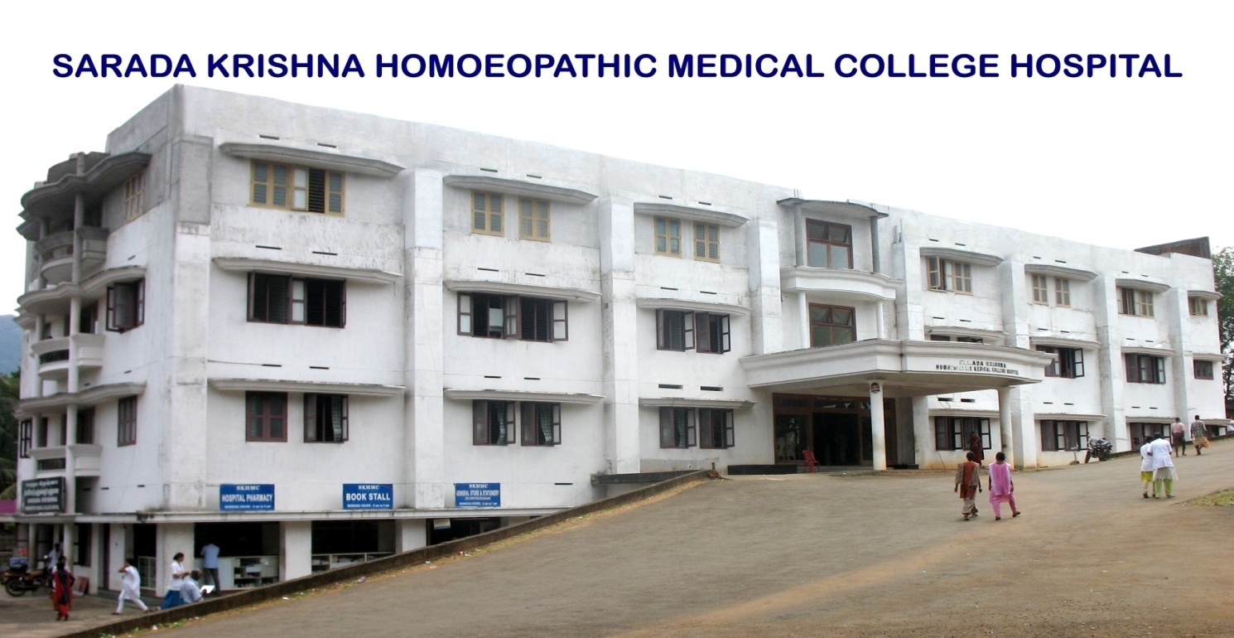

Slide 37
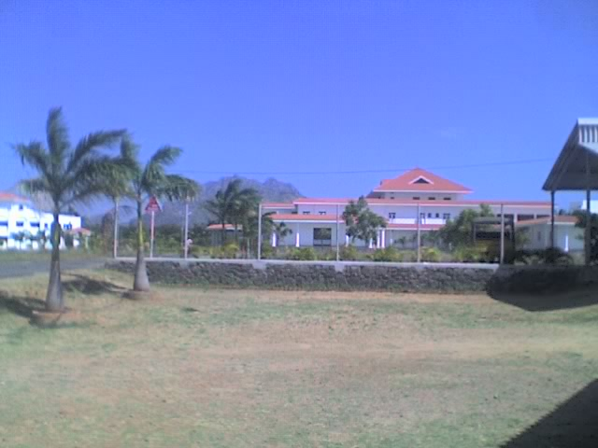
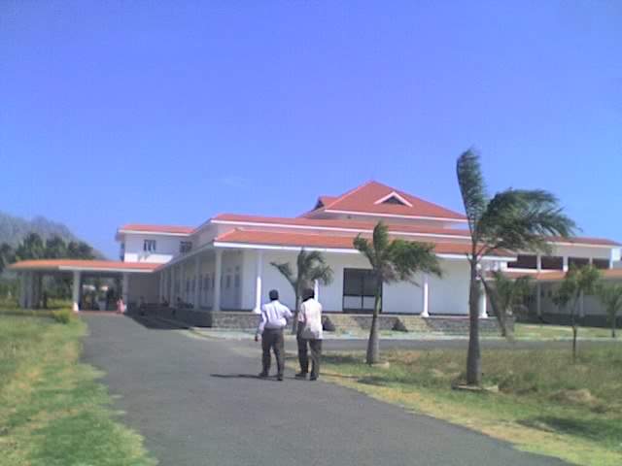
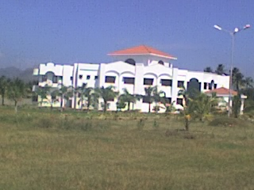
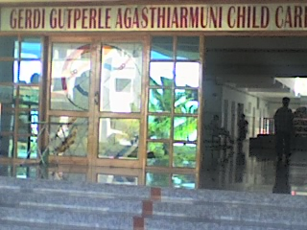
Gerdi Gutperle Agasthiarmuni Child Care Centre, Vellamadam, Nagercoil

Slide 38
Future Visions & plan….

Slide 39
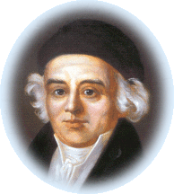
‘ REST !’ have I ever rested ? Forward, ever forward…………
- Dr. Samuel Hahnemann.

Slide 40
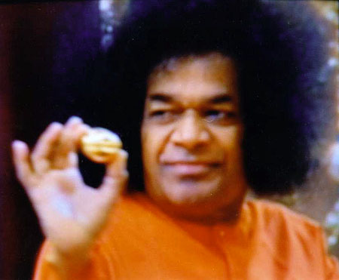
THANK YOU ALL

